Slide 1
Externalities
CHAPTER 10
Notes:
N. Gregory Mankiw Principles Of Economics Eight Edition

Slide 2
Externalities, Part 1
Government action can sometimes improve upon market outcomes
Why markets sometimes fail to allocate resources efficiently
How government policies can potentially improve the market’s allocation
What kinds of policies are likely to work best

Slide 3
Externalities, Part 2
Externality
The uncompensated impact of one person’s actions on the well-being of a bystander
Market failure
Negative externality
Impact on the bystander is adverse
Positive externality
Impact on the bystander is beneficial

Slide 4
Externalities, Part 3
Negative externalities
Exhaust from automobiles
Barking dogs
Positive externalities
Restored historic buildings
Research into new technologies

Slide 5
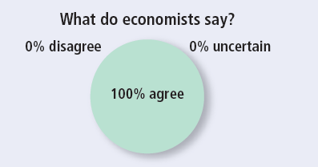
ASK THE EXPERTS, Part 1
Vaccines
“Declining to be vaccinated against contagious diseases such as measles imposes costs on other people, which is a negative externality.”

Slide 6
Externalities and Market Inefficiency, Part 1
Welfare economics: A recap
Demand curve: value to consumers
Prices they are willing to pay
Supply curve: cost to suppliers
Equilibrium quantity and price
Efficient
Maximizes the sum of producer and consumer surplus

Slide 7
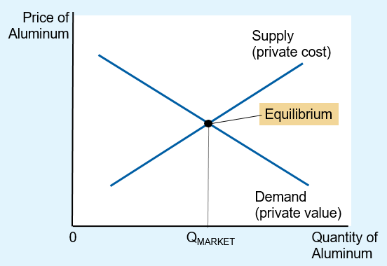
Figure 1 The Market for Aluminum
The demand curve reflects the value to buyers, and the supply curve reflects the costs of sellers. The equilibrium quantity, Q_{MARKET}, maximizes the total value to buyers minus the total costs of sellers. In the absence of externalities, therefore, the market equilibrium is efficient.

Slide 8
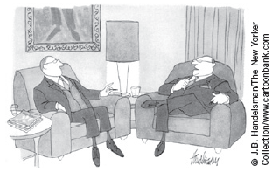
Externalities and Market Inefficiency, Part 2
Negative externalities
Cost to society (of producing a good)
Larger than the cost to the good producers
“All I can say is that if being a leading manufacturer means being a leading polluter, so be it.”

Slide 9
Externalities and Market Inefficiency, Part 3
Negative externalities
Social cost
Private costs of the producers (supply)
Plus the costs to those bystanders affected adversely by the negative externality
Social cost curve is above the supply curve
Takes into account the external costs imposed on society

Slide 10
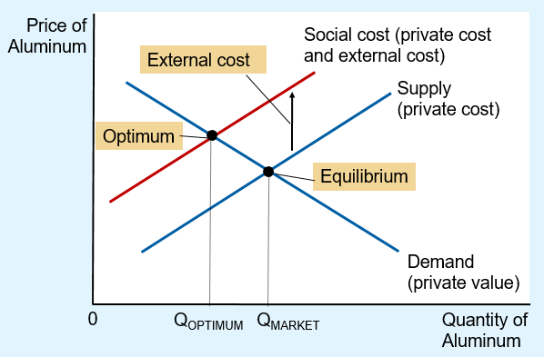
Figure 2 Pollution and the Social Optimum
In the presence of a negative externality, such as pollution, the social cost of the good exceeds the private cost. The optimal quantity, Q_{OPTIMUM}, is therefore smaller than the equilibrium quantity, Q_{MARKET}.

Slide 11
Externalities and Market Inefficiency, Part 4
Negative externalities
Optimum quantity produced
Maximize total welfare
Smaller than market equilibrium quantity
Government – correct market failure
Internalizing the externality
Altering incentives so that people take account of the external effects of their actions

Slide 12
Externalities and Market Inefficiency, Part 5
Positive externalities
Education
Benefit of education is private
Externalities: better government, lower crime rates, higher productivity and wages
Social value is greater than private value
Social value curve
Above the demand curve

Slide 13
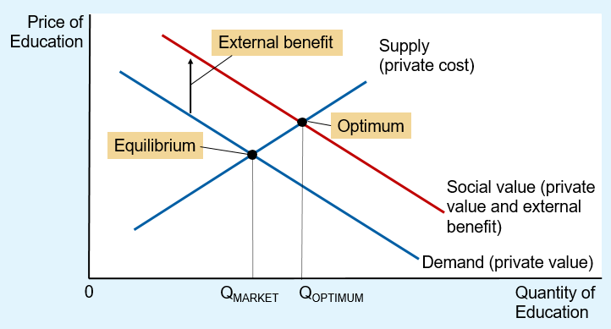
Figure 3 Education and the Social Optimum
In the presence of a positive externality, the social value of the good exceeds the private value. The optimal quantity, Q_{OPTIMUM}, is therefore larger than the equilibrium quantity, Q_{MARKET}.

Slide 14
Externalities and Market Inefficiency, Part 6
Positive externalities
Socially optimal quantity is greater than market equilibrium quantity
Government – correct market failure
Internalize the externality
Subsidy

Slide 15
Externalities and Market Inefficiency, Part 7
Negative externalities
Markets produce a larger quantity than is socially desirable
Government: tax
Positive externalities
Markets produce a smaller quantity than is socially desirable
Government: subsidy

Slide 16
Technology spillovers, industrial policy, and patent protection, Part 1
Technology spillover = Positive externality
Impact of one firm’s research and production efforts on other firms’ access to technological advance
Government: internalize the externality
Subsidy = value of the technology spillover

Slide 17
Technology spillovers, industrial policy, and patent protection, Part 2
Industrial policy
Government intervention in the economy that aims to promote technology-enhancing industries
Patent law
Protect the rights of inventors by giving them exclusive use of their inventions for a period of time

Slide 18
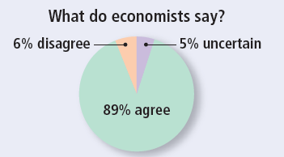
ASK THE EXPERTS, Part 2
Vaccines
“Considering the costs of restricting free choice, and the share of people in the US who choose not to vaccinate their children for measles, the social benefit of mandating measles vaccines for all Americans (except those with compelling medical reasons) would exceed the social cost.”

Slide 19
Public Policies toward Externalities, Part 1
Command-and-control policies
Regulate behavior directly
Regulation
Market-based policies
Provide incentives so that private decision makers will choose to solve the problem on their own
Corrective taxes and subsidies
Tradable pollution permits

Slide 20
Public Policies toward Externalities, Part 2
Regulation
Regulate behavior directly: making certain behaviors either required or forbidden
Cannot eradicate pollution
Environmental Protection Agency (EPA)
Develop and enforce regulations
Dictates maximum level of pollution
Requires that firms adopt a particular technology to reduce emissions

Slide 21
Public Policies toward Externalities, Part 3
Corrective taxes and subsidies
Corrective taxes (Pigovian taxes)
Induce private decision makers to take account of the social costs that arise from a negative externality
Places a price on the right to pollute
Reduce pollution at a lower cost to society
Raise revenue for the government
Enhance economic efficiency

Slide 22
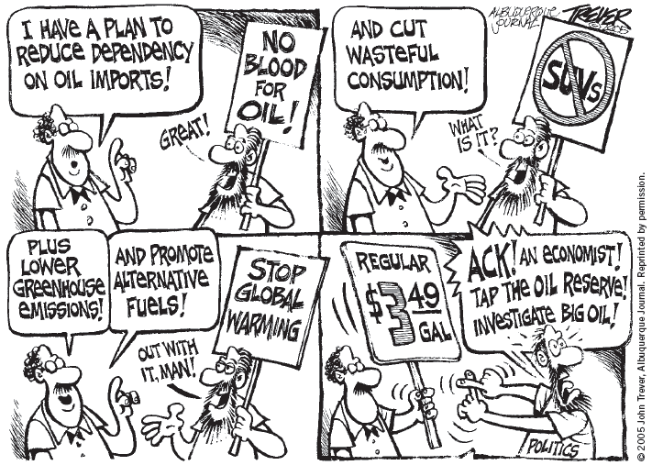
Why is gasoline taxed so heavily?, Part 1
Negative externalities associated with driving
Congestion, accidents, pollution

Slide 23
Why is gasoline taxed so heavily?, Part 2
The gas tax = corrective tax
Doesn’t cause deadweight losses
Makes the economy work better
Less traffic congestion
Safer roads
Cleaner environment

Slide 24
Why is gasoline taxed so heavily?, Part 3
How high should the tax on gasoline be?
Most European countries
Higher gasoline tax than in the U.S.
2007, Journal of Economic Literature
Optimal corrective tax on gasoline
$2.28 per gallon in 2005 dollars
$2.78 per gallon in 2012 dollars
Actual tax in the U.S. in 2015:
50 cents per gallon

Slide 25
Why is gasoline taxed so heavily?, Part 4
Tax revenue from a gasoline tax
Used to lower taxes that distort incentives and cause deadweight losses
Some government regulations
Production of fuel-efficient cars – unnecessary

Slide 26
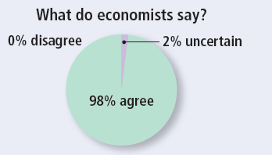
ASK THE EXPERTS, Part 3
Carbon Taxes
“The Brookings Institution recently described a U.S. carbon tax of $20 per ton, increasing at 4 percent per year, which would raise an estimated $150 billion per year in federal revenues over the next decade. Given the negative externalities created by carbon dioxide emissions, a federal carbon tax at this rate would involve fewer harmful net distortions to the U.S. economy than a tax increase that generated the same revenue by raising marginal tax rates on labor income across the board.”

Slide 27
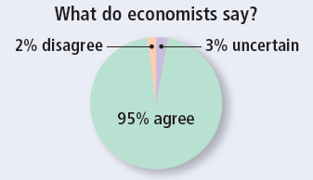
ASK THE EXPERTS, Part 4
Carbon Taxes
“A tax on the carbon content of fuels would be a less expensive way to reduce carbon-dioxide emissions than would a collection of policies such as ‘corporate average fuel economy’ requirements for automobiles.”

Slide 28
Public Policies toward Externalities, Part 4
Tradable pollution permits
Voluntary transfer of the right to pollute from one firm to another
New scarce resource: pollution permits
Market to trade permits
Firm’s willingness to pay
Depend on its cost of reducing pollution

Slide 29
Public Policies toward Externalities, Part 5
Advantage of free market for pollution permits
Initial allocation of pollution permits doesn't matter
If firms can reduce pollution at a low cost:
Sell whatever permits they get
If firms can reduce pollution only at a high cost: buy whatever permits they need
Efficient final allocation

Slide 30
Public Policies toward Externalities, Part 6
Reducing pollution using pollution permits or corrective taxes
Firms pay for their pollution
Corrective taxes: pay to the government
Pollution permits: pay to buy permits
Internalize the externality of pollution

Slide 31
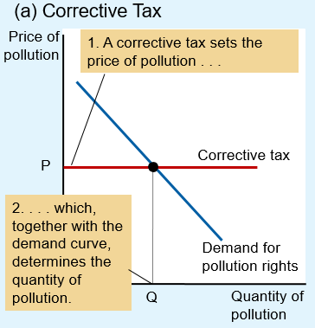
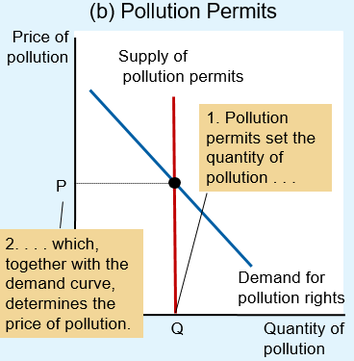
Figure 4 The Equivalence of Corrective Taxes and Pollution Permits
In panel (a), the EPA sets a price on pollution by levying a corrective tax, and the demand curve determines the quantity of pollution. In panel (b), the EPA limits the quantity of pollution by limiting the number of pollution permits, and the demand curve determines the price of pollution. The price and quantity of pollution are the same in the two cases.

Slide 32
Public Policies toward Externalities, Part 7
Objections to the economic analysis of pollution
“We cannot give anyone the option of polluting for a fee.” – late Senator Edmund Muskie
People face trade-offs
Eliminating all pollution is impossible
Clean water and clean air — opportunity cost: lower standard of living

Slide 33
Public Policies toward Externalities, Part 8
Clean environment is a normal good
Positive income elasticity
Rich countries can afford a cleaner environment
More rigorous environmental protection
Clean air and clean water – law of demand
The lower the price of environmental protection
The more the public will want it

Slide 34
Private Solutions to Externalities, Part 1
The types of private solutions
Moral codes and social sanctions
Charities
Self-interest of the relevant parties
Integrating different types of businesses
Interested parties can enter into a contract

Slide 35
Private Solutions to Externalities, Part 2
The Coase theorem
If private parties can bargain without cost over the allocation of resources
They can solve the problem of externalities on their own
Whatever the initial distribution of rights
Interested parties can reach a bargain:
Everyone is better off
Outcome is efficient

Slide 36
Private Solutions to Externalities, Part 3
1. Dick has the legal right to keep a barking dog.
Dick gets a $500 benefit from the dog
Jane bears an $800 cost from the barking
Efficient outcome:
Jane can offer Dick $600 to get rid of the dog
Dick will gladly accept

Slide 37
Private Solutions to Externalities, Part 4
2. Dick has the legal right to keep a barking dog.
Dick gets a $1,000 benefit from the dog
Jane bears an $800 cost from the barking
Efficient outcome:
Dick turns down any offer below $1,000
Jane will not offer any amount above $800
Dick keeps the dog

Slide 38
Private Solutions to Externalities, Part 5
3. Jane can legally compel Dick to get rid of the dog.
Dick can offer to pay Jane to allow him to keep the dog
If the benefit of the dog to Dick exceeds the cost of the barking to Jane
Then Dick and Jane will strike a bargain in which Dick keeps the dog

Slide 39
Private Solutions to Externalities, Part 6
Why private solutions do not always work
High transaction costs
Costs that parties incur in the process of agreeing to and following through on a bargain
Bargaining simply breaks down
Large number of interested parties
Coordinating everyone is costly

